Slide 1
Genius Hour Project

Slide 2

Hello!
I am Nikhil Gupta
I am here to showcase my 20 Time Project

Slide 3
How did I start?
-Intrigued by electronics
Notes:
Heard about a friend who made a electronic skate. I thought that was pretty cool.
Another thing I liked was that they were hackable and possibilities were endless

Slide 4
“Electronics have made our lives infinitely easier and wonderfully convenient”
-Me
Notes:
Look around you there are elecronics everywhere

Slide 5
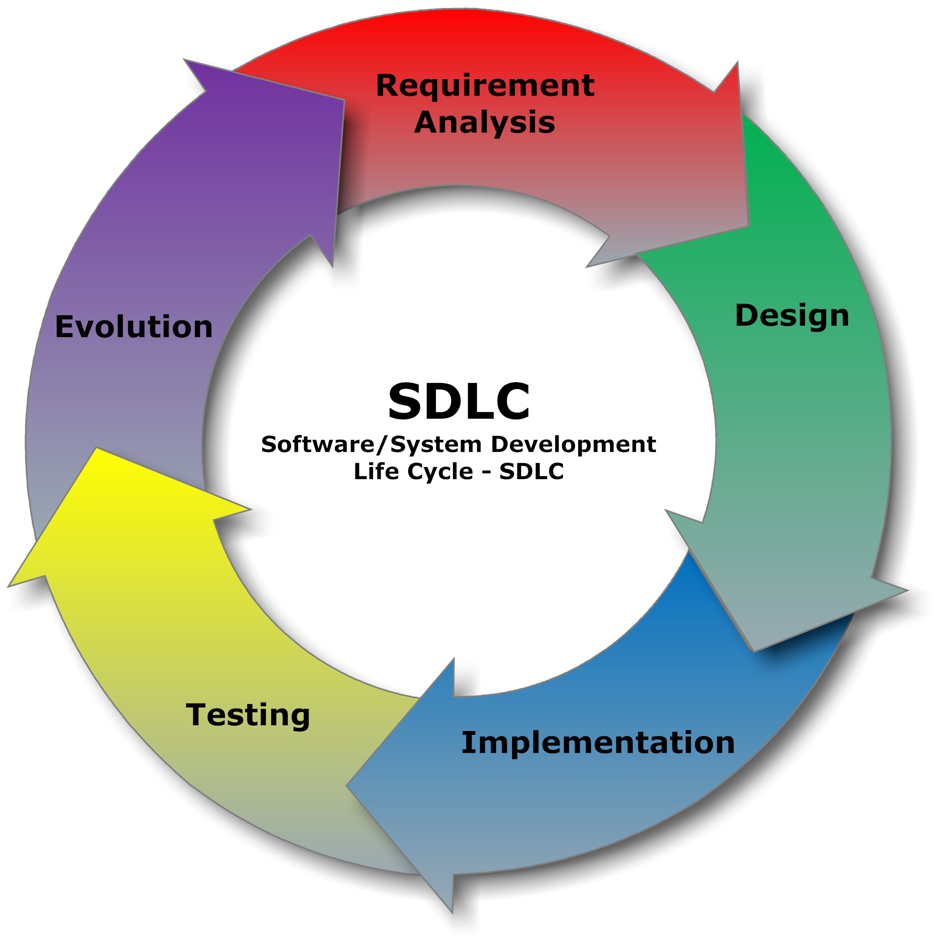
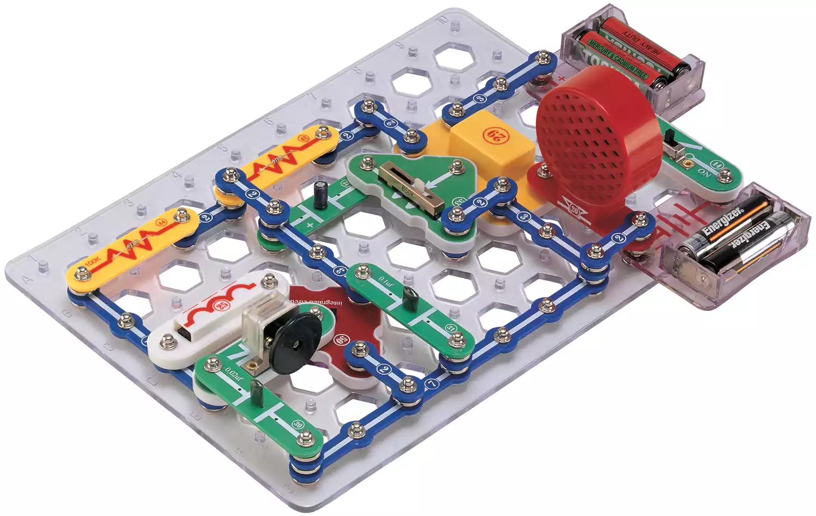
What I did for my first 4 weeks?
Researched about AutoCAD
Circuits
Development cycle
Some more circuits
“Snap Circuits”
Notes:
Computer-aided design (CAD)

Slide 6

How I felt after that

Slide 7

Raspberry Pi
Notes:
I came across Raspberry Pi and I found the concept of making small computers that I can set up for different purposes irresistible

Slide 8
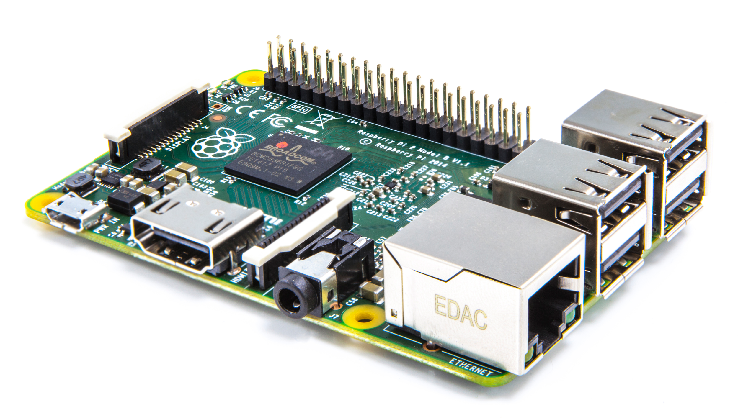
Notes:
I’ll bring mine as an exhibit

Slide 9
 | Raspberry Pi 3 | Raspberry Pi 2 | Raspberry Pi Zero
Release date | 2016 Feb 29 | 2015 Feb 1 | 2015 Nov 30
Product details
Price | US$35.00 | US$35.00 | US$5.00
SOC
Core Type | Cortex-A53 64-bit | Cortex-A7 | ARM1176JZF-S
No. Of Cores | 4 | 4 | 1
GPU | VideoCore IV | VideoCore IV | VideoCore IV
CPU Clock | 1.2 GHz | 900 MHz | 1 GHz
RAM | 1 GB | 1 GB | 512 MB
Wired Connectivity
USB Ports | Yes 4 | Yes 4 | Yes micro + micro OTG
Ethernet | Yes | Yes 10/100M | No
SATA Ports | No | No | No
HDMI | Yes | Yes | Yes mini
Analog Video Out | Yes shared with audio jack | Yes shared with audio jack | Yes via unpopulated pin
Analog Audio Out | Yes | Yes | - HDMI audio
Analog Audio In | No | No | No
LCD Panel | Yes | Yes | No
Camera | Yes | Yes | Yes latest version include a camera connector
SD/MMC | Yes microSD | Yes microSD | Yes microSD
Wireless Connectivity (On-Board)
Wi-Fi | Yes 802.11n | No | No
Bluetooth® | Yes 4.1 | No | No
Notes:
Not much bigger than a credit card as you can see

Slide 10
What can you do with it?
I’m glad you asked. Pretty much anything you want...
Some really cool projects that I found are:
MagicMirror
Minecraft Pi
RetroPie
Plex Media Server
360 Camera
Jukebox/ Pi MusicBox
FM Radio receiver
Web Server
Notes:
RetroPie: bringing simple-to-use arcade and console emulation to the Raspberry Pi with very little fuss
Minecraft Pi: Code in minecraft
360 Camera: uploads videos directly to youtube

Slide 11
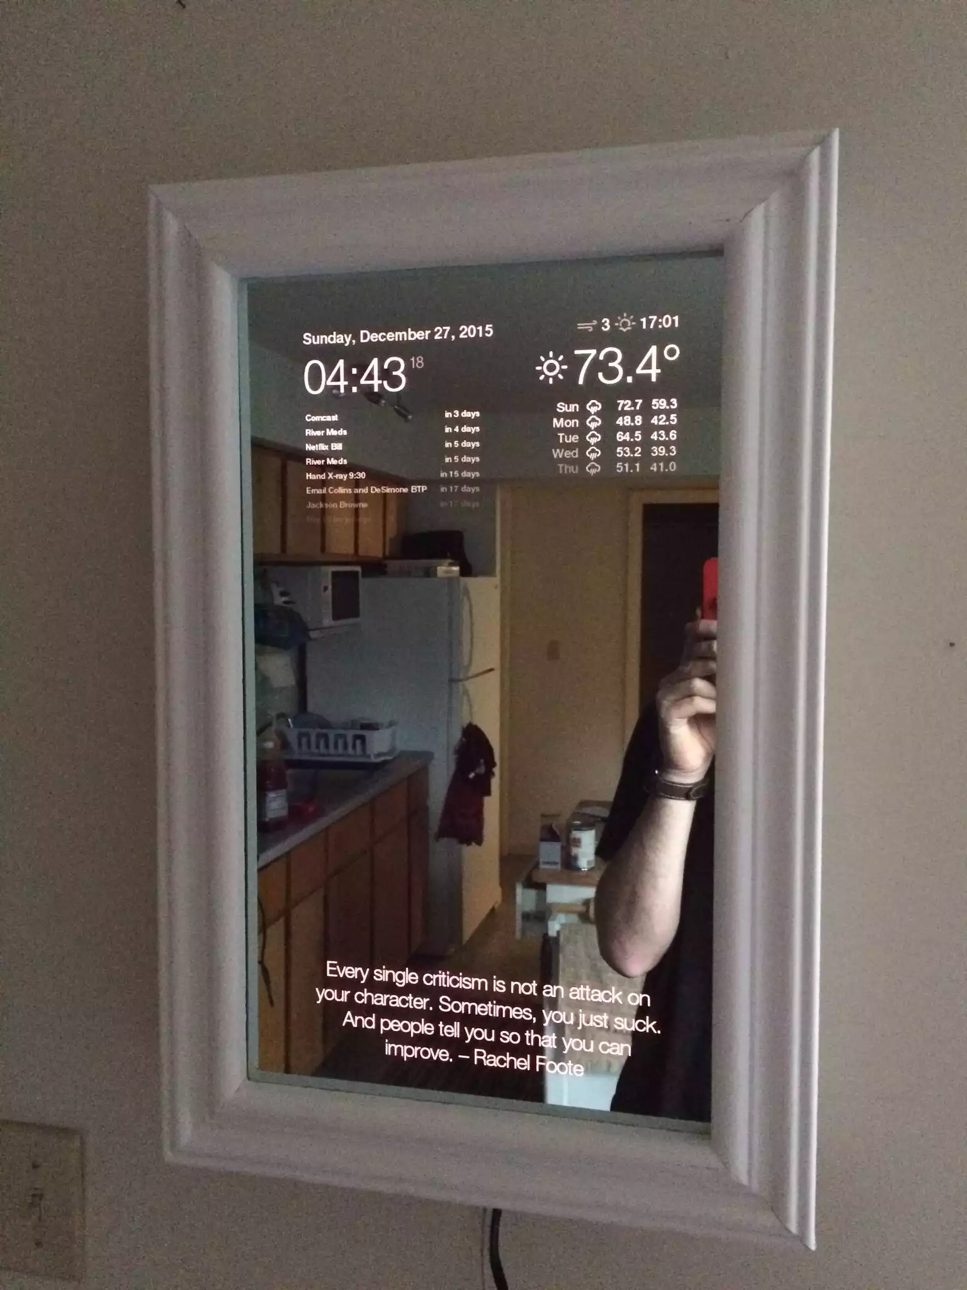
MagicMirror

Slide 12

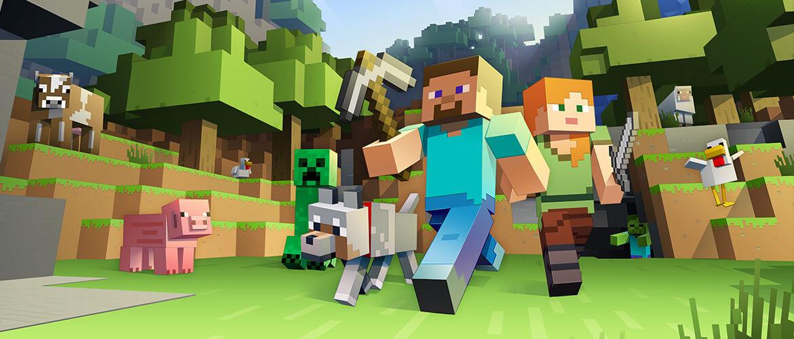

Slide 13

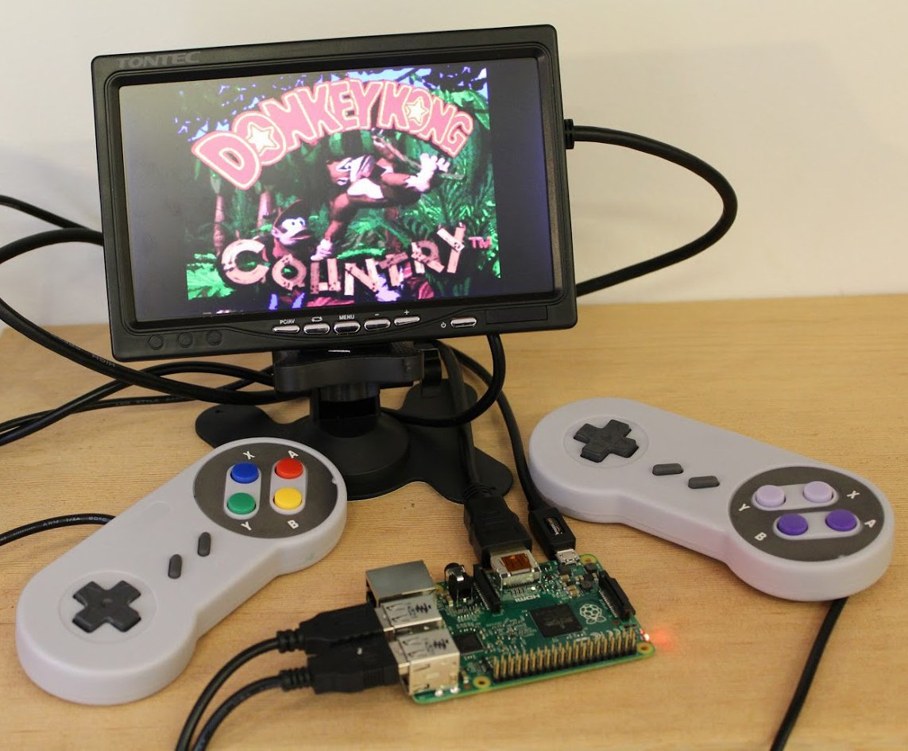

Slide 14
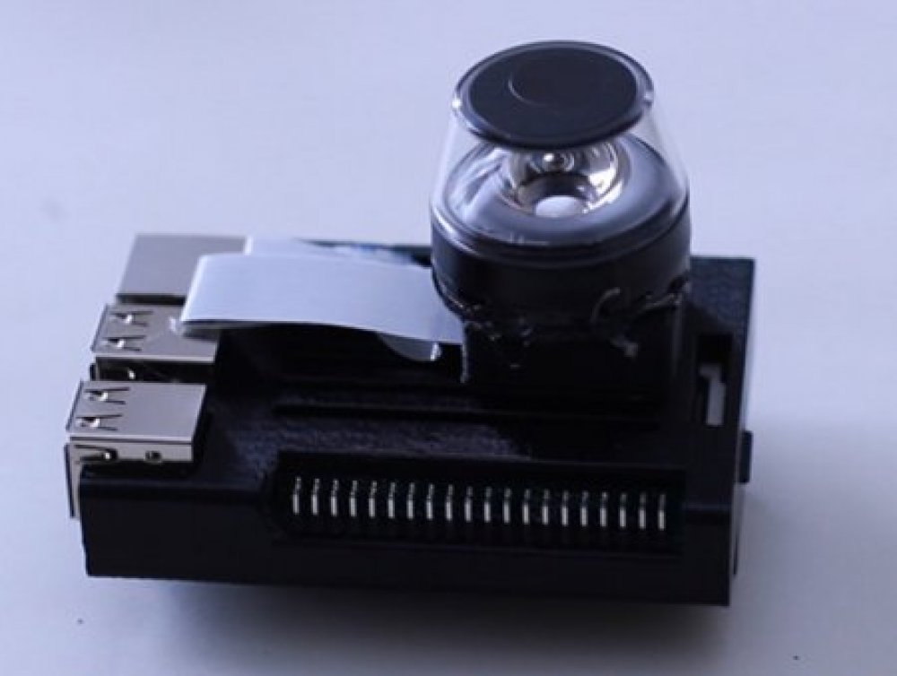
360 Camera

Slide 15

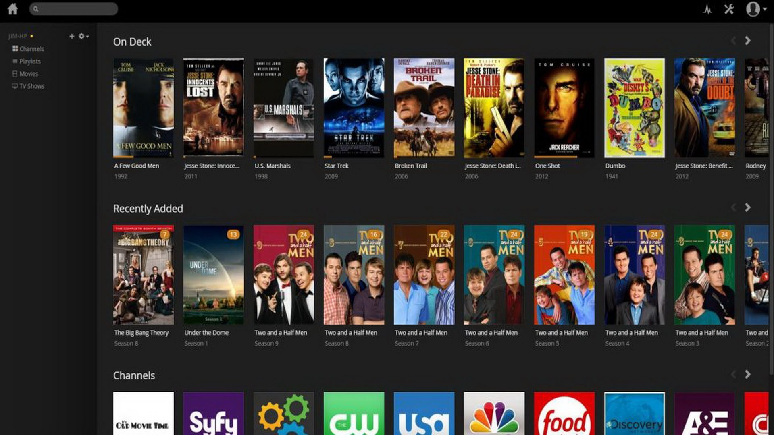

Slide 16
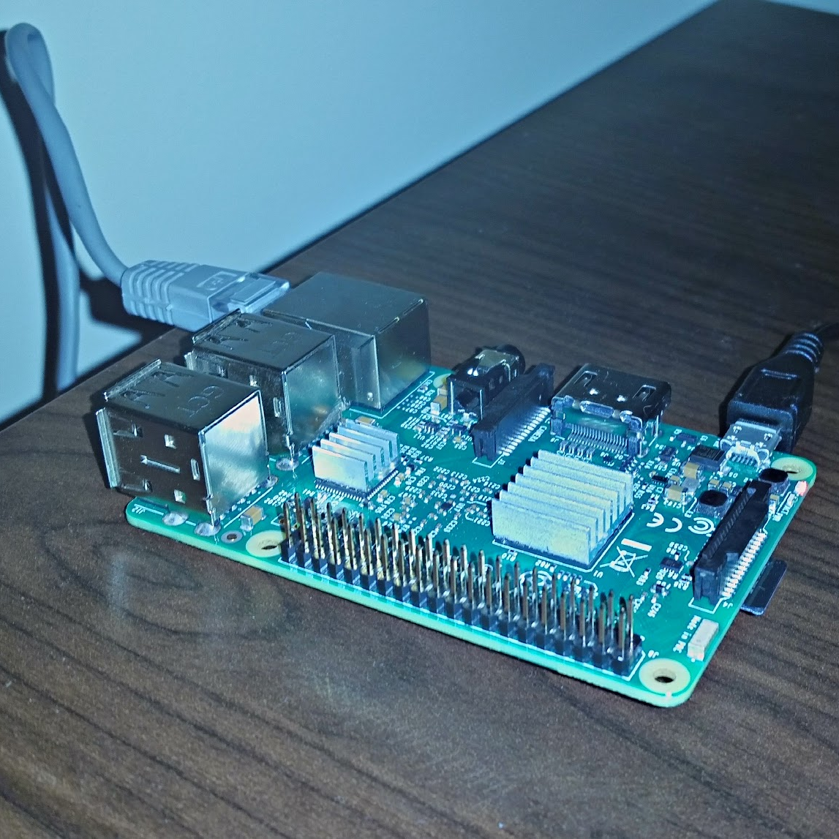
My project in its current state
Complete headless setup (access through remote PC)
Using it as Plex Media Server
Added the option to use external storage as a source for media
Working on creating a web site to host on my raspberry pi!

Slide 17
What do you need to setup Plex?
A plex account
Plex media server
… That’s it Enjoy!

Slide 18
Possibilities of a Media Server at your home
Nerd
Stream movies and TV shows (No Internet needed!)
Stream music (No Internet needed!)
“Fling” photos to TV
Access the media you “own” anywhere (Internet needed)
Total success!
Notes:
Stream movies to any device around the home without burning through your data cap. Also, safer than streaming illegally online because they can see your IP address.

Slide 19
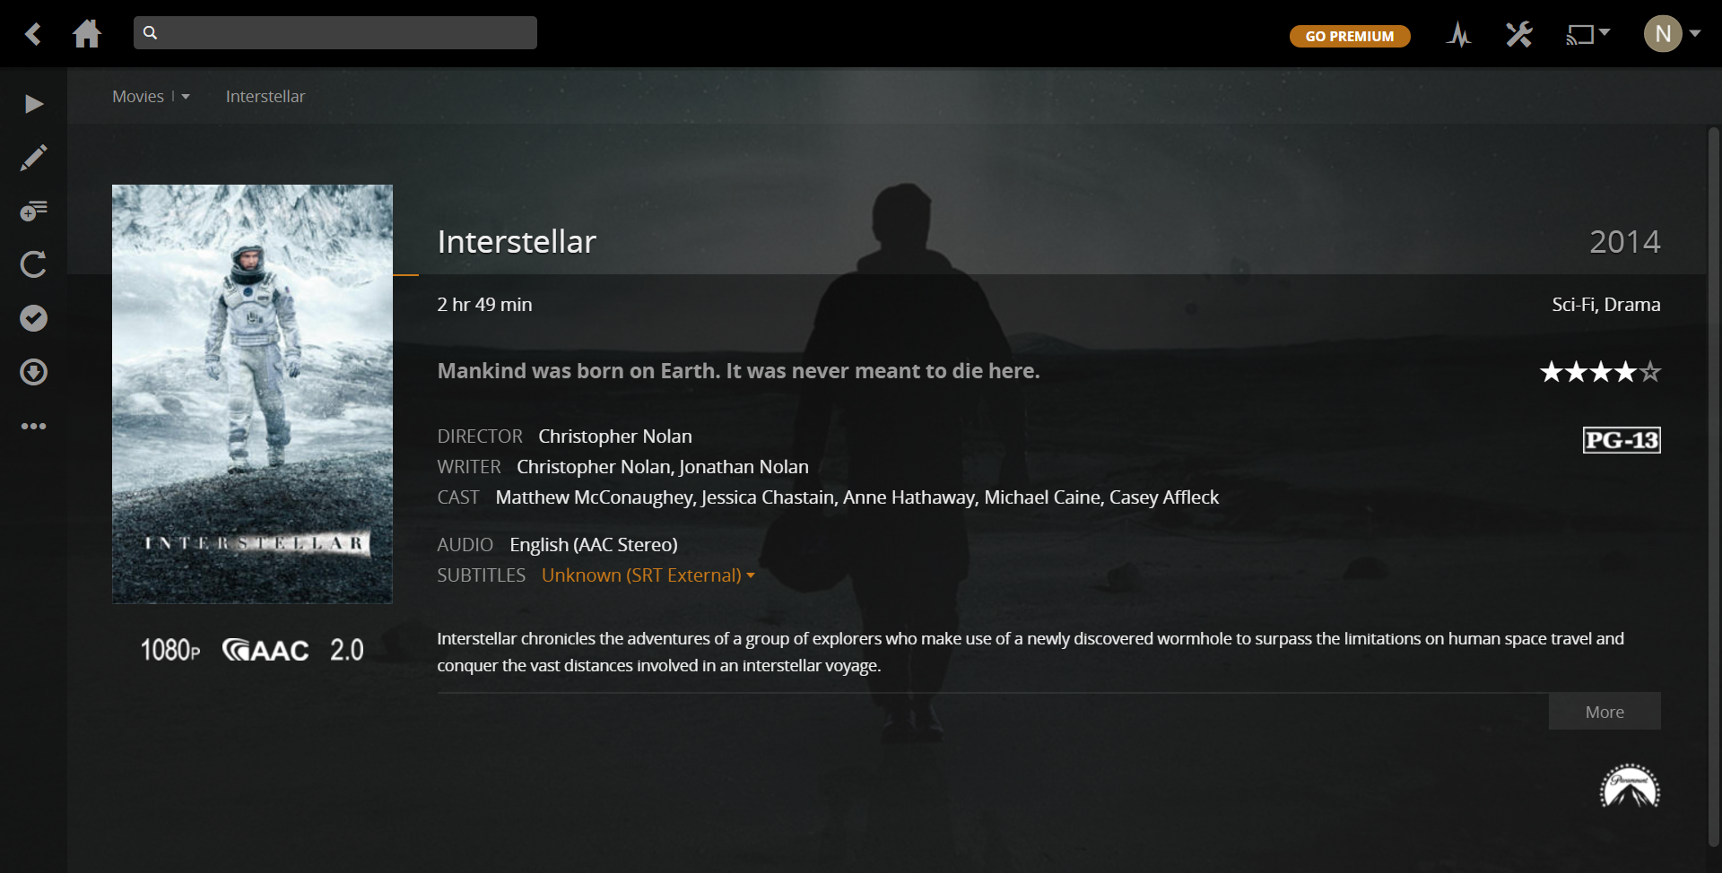
Why I like Plex
Organizes all your media beautifully, without any storage limit, adding metadata automatically without storing any data on their server (we don’t use pirated content, right?).
Place your screenshot here

Slide 20
Challenges I faced
Time
Information Overload
Lack of Motivation
Lack of Direction
Boredom
Procrastination
Notes:
Procrastination
Bored
Don’t know what do next

Slide 21
Future Projects on Raspberry Pi
Full Fledged
Web Server
Remote Control like a TV
Safety Camera
Notes:
Fun Fact: TBA : To be announced

Slide 22
10,000,000
Number of Raspberry Pis sold worldwide
Notes:
You are not alone!

Slide 23
Thanks!
Any questions?

